Slide 1
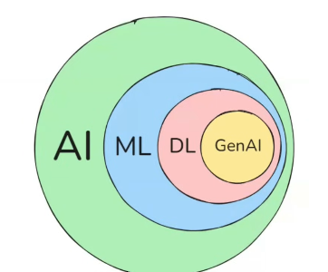

π
Chains
Langchain
Neural network & History
Component of Neural network
Activation Function
Notes:
Content: https://www.linkedin.com/pulse/chunking-strategies-ai-data-kash-kashyap-0lghe/

Slide 2
Chains
Chains are a series of steps and action
Chains allow us to combine multiple component together to solve a specific task and build an entire LLM Application
Notes:
Content: https://www.linkedin.com/pulse/chunking-strategies-ai-data-kash-kashyap-0lghe/

Slide 3
Notes:
Content: https://www.linkedin.com/pulse/chunking-strategies-ai-data-kash-kashyap-0lghe/

Slide 4
Notes:
Content: https://www.linkedin.com/pulse/chunking-strategies-ai-data-kash-kashyap-0lghe/

Slide 5
Notes:
Content: https://www.linkedin.com/pulse/chunking-strategies-ai-data-kash-kashyap-0lghe/

Slide 6
Notes:
Content: https://www.linkedin.com/pulse/chunking-strategies-ai-data-kash-kashyap-0lghe/

Slide 7
Notes:
Content: https://www.linkedin.com/pulse/chunking-strategies-ai-data-kash-kashyap-0lghe/

Slide 8
Notes:
Content: https://www.linkedin.com/pulse/chunking-strategies-ai-data-kash-kashyap-0lghe/

